Slide 1
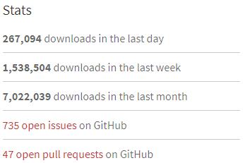

webpack
unpacked
Alexander Pittendrigh Software Engineer Entelect
Notes:
Afternoon everyone,
I’m Alexander Pittendrigh, a software engineer at Entelect and a first time JSinSA speaker.
Here to talk about a powerful build and dev tool called webpack.
webpack is at least four years old, and is now in it’s second major version, so there are likely audience members familiar with webpack, so hopefully I can teach those people something they didn’t know, or show them a cool feature they’re were unaware of.
I know some people who’ve used webpack but don’t understand how it works, so hopefully I can demystify it a little.
I’m going to walk through a basic setup and then introduce some features that most people are likely to use.
We’ve been using it to bundle production application for the last five months.

Slide 2
bundler
before bundling Javascript dependencies were managed by including files in a specific order
bundles reduce the number of http request made to the server
everything was put into global scope
sometimes subsequent dependencies modified how other dependencies worked
Notes:
At the heart of it, Webpack is a bundling tool.
In the early days, we "managed" Javascript dependencies by including files in a specific order
But it also allows you to make some changes to your code at build time.
You could, for example change, change the base API URL used by your web application while you build it.
We’ve been using it to bundle production application for the last five months.

Slide 3
installation
npm install webpack
or npm install webpack@latest
Add –g for global install
Notes:
The webpack.config.js file tells webpack how to interpret your application.
A basic config file allows webpack to bundle JavaScript dependencies, which webpack supports without any additional loaders.
From the comments above you can see that the entry property is used to tell webpack where to start and the output object’s; property, filename, tells webpack what to call the bundle.
If, while digesting your application webpack finds a file that it doesn’t know how to bundle, it will throw an error.
So, if you imported anything that didn’t end in .js it wouldn’t know what to do with it.
(git checkout example1)

Slide 4
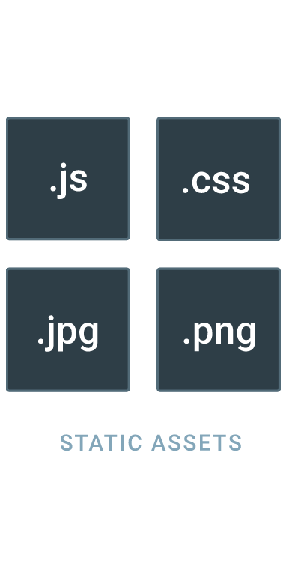
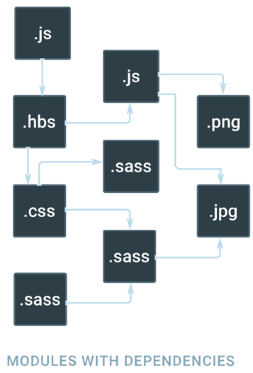
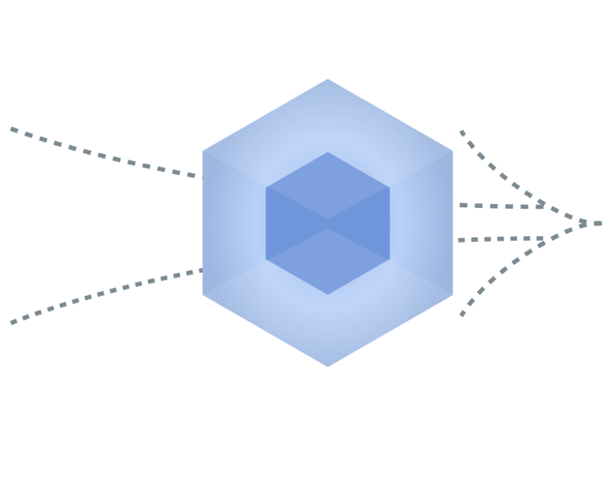
Notes:
Webpack works by running through your application as your browser would.
It follows the trail of imports your application makes, builds a dependency graph and bundles the resultant dependencies.
Webpack supports AMD, commonJS and harmony (ES2015) imports.
It builds up the dependency graph, runs it through all the loaders you’ve configured in your config file and bundles the dependencies.

Slide 5
webpack.config.js
the thing that tells webpack how to bundle your app
Notes:
The webpack.config.js file tells webpack how to interpret your application.
A basic config file allows webpack to bundle JavaScript dependencies, which webpack supports without any additional loaders.
From the comments above you can see that the entry property is used to tell webpack where to start and the output object’s; property, filename, tells webpack what to call the bundle.
If, while digesting your application webpack finds a file that it doesn’t know how to bundle, it will throw an error.
So, if you imported anything that didn’t end in .js it wouldn’t know what to do with it.
(git checkout example1)

Slide 6
module.exports = {
// where to start
entry: './app.js’,
output: {
// what to output
filename: 'bundle.js’
}
}

Slide 7
es2015
Notes:
Hot Module Replacement (or HMR) is one of the most useful features offered by webpack. It allows all kinds of modules to be updated at runtime without the need for a full refresh.

Slide 8
loaders
every dependency your application has is viewed as a module
the bundling of modules is facilitated by loaders
loaders are dev dependencies used by webpack
Notes:
(show the sample.webpack.config.js)
Everything is a module - This mean we can split any artifact into smaller manageable pieces, reuse them and so on.
The problem with the webpack.config is that it has unique syntax and unusual philosophies.
The irony is that these philosophies are what make webpack so popular.
Loaders work at the individual file level during or before the bundle is generated.
When loaders are chained they work from right to left

Slide 9
hot module replacement
Notes:
Hot Module Replacement (or HMR) is one of the most useful features offered by webpack. It allows all kinds of modules to be updated at runtime without the need for a full refresh.

Slide 10
source-maps
Notes:
(example4)

Slide 11
build environmental vars
Notes:
example5

Slide 12
build time changes
Notes:
example6

Slide 13
styles
achieved with css-loader and style-loader
Notes:
so, we all know that website aren’t just Javascript and HTML, sometimes you have to write CSS.
css-loader : takes care of loading and understanding the css
style-loader : takes the content of the css and inject’s a style tag into the head of the page

Slide 14
images
file-loader
The url-loader works like the file-loader, but can return a DataURL if the file is smaller than a byte limit.
Notes:
(example8)
(example8.1)

Slide 15
tree-shaking
only works with ES6 modules
you need webpack > 1 for this
remember to tell babel not to transpile the modules
done wit hUglifyjs plugin
Notes:
Hot Module Replacement (or HMR) is one of the most useful features offered by webpack. It allows all kinds of modules to be updated at runtime without the need for a full refresh.
Webpack 1 turns es modules into commonjs modules, then tree-shaking doesn’t work. Webpack 2 understands es6 modules out the box, so you need to stop Babel from transpiling to get tree shaking to work.
To remove this code we need to use uglifyjs (mangler, compressor, beautifier)
Show them that module.hot.accept is also gone
Show if (__isDebug__) {
console.log('loaded!’)
} stuff

Slide 16
webpack.js.org
https://webpack.js.org/loaders/
https://webpack.js.org/plugins/
Notes:
As you might have realized, Loaders work at the individual file level during or before the bundle is generated.
Where as Plugins work at bundle or chunk level and usually work at the end of the bundle generation process.

